Slide 1
Financial manager
Course Project for CSCI 352
Lucian Freeze/Brett Whitson

Slide 2
Overview
Background
Approach
Class Diagram
Demo
Future Work
Questions

Slide 3
Background
This project is an application that students can use to keep track of and control their spending with an easy-to-use streamlined interface.
We decided on this because we as low-income college students could use this kind of application in every day life.

Slide 4
Approach
We utilized the relational database tools to store user account data and SQL to query from the database.
One design pattern we used was the abstract factory pattern to create theming within the application.

Slide 5
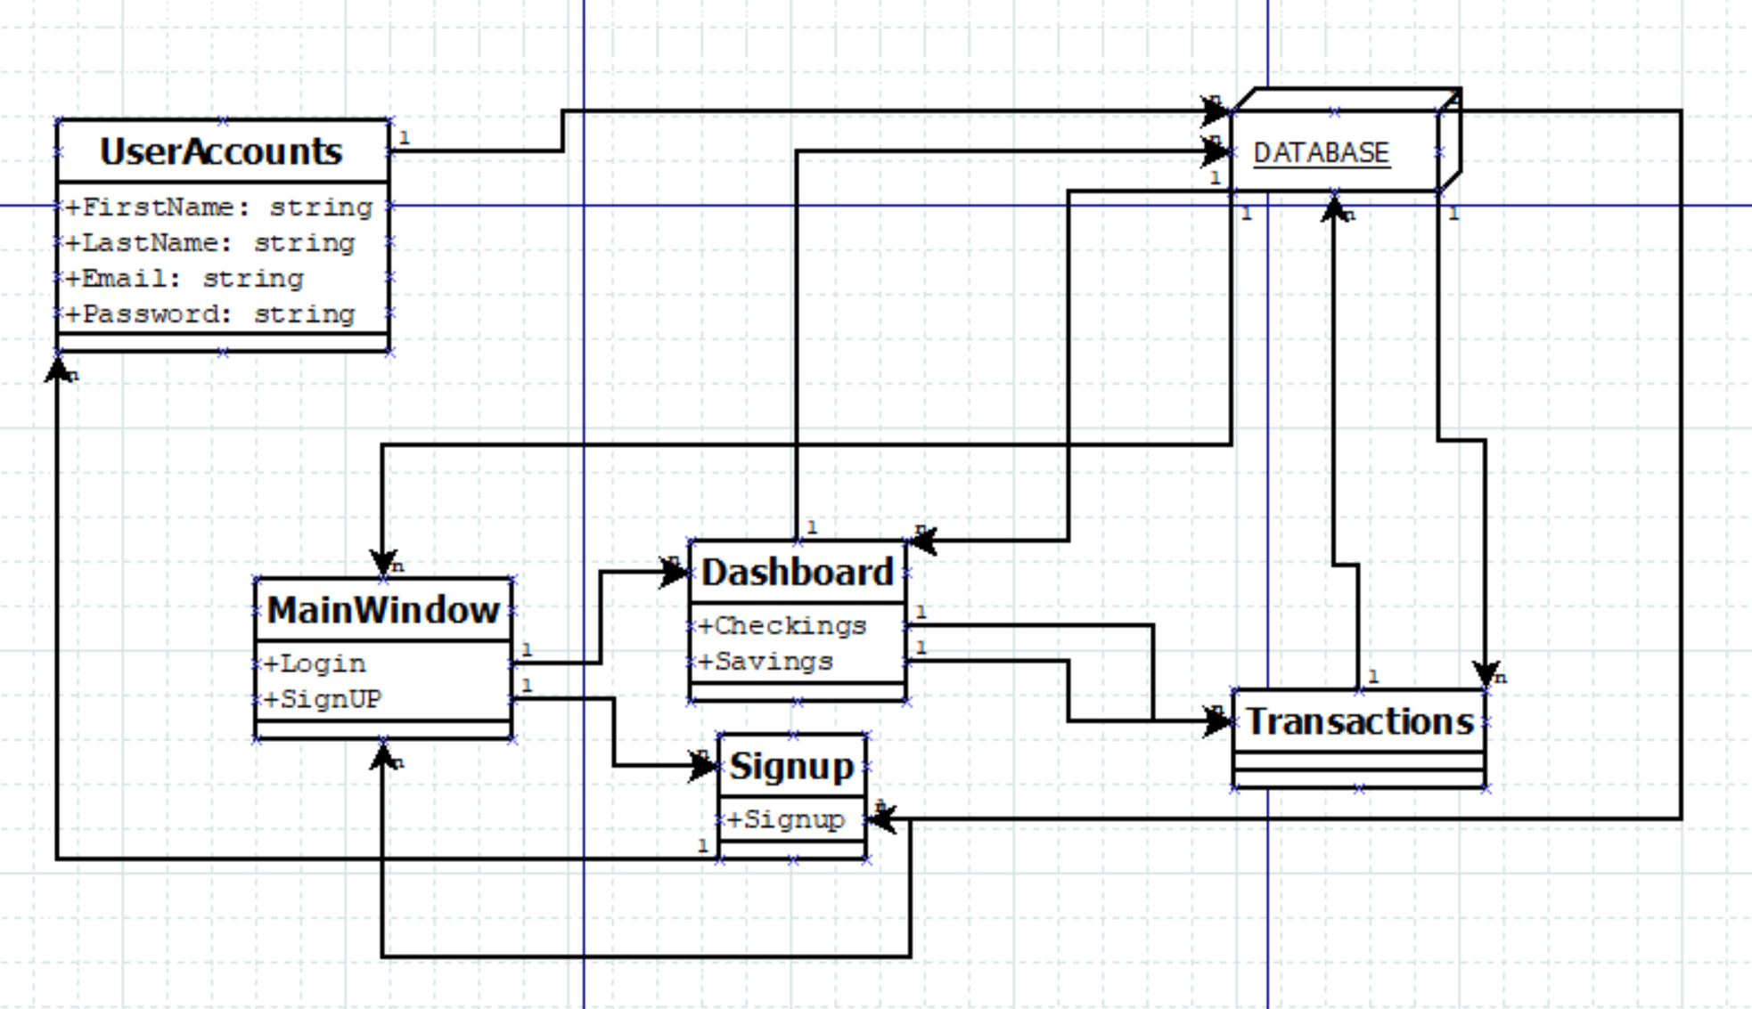
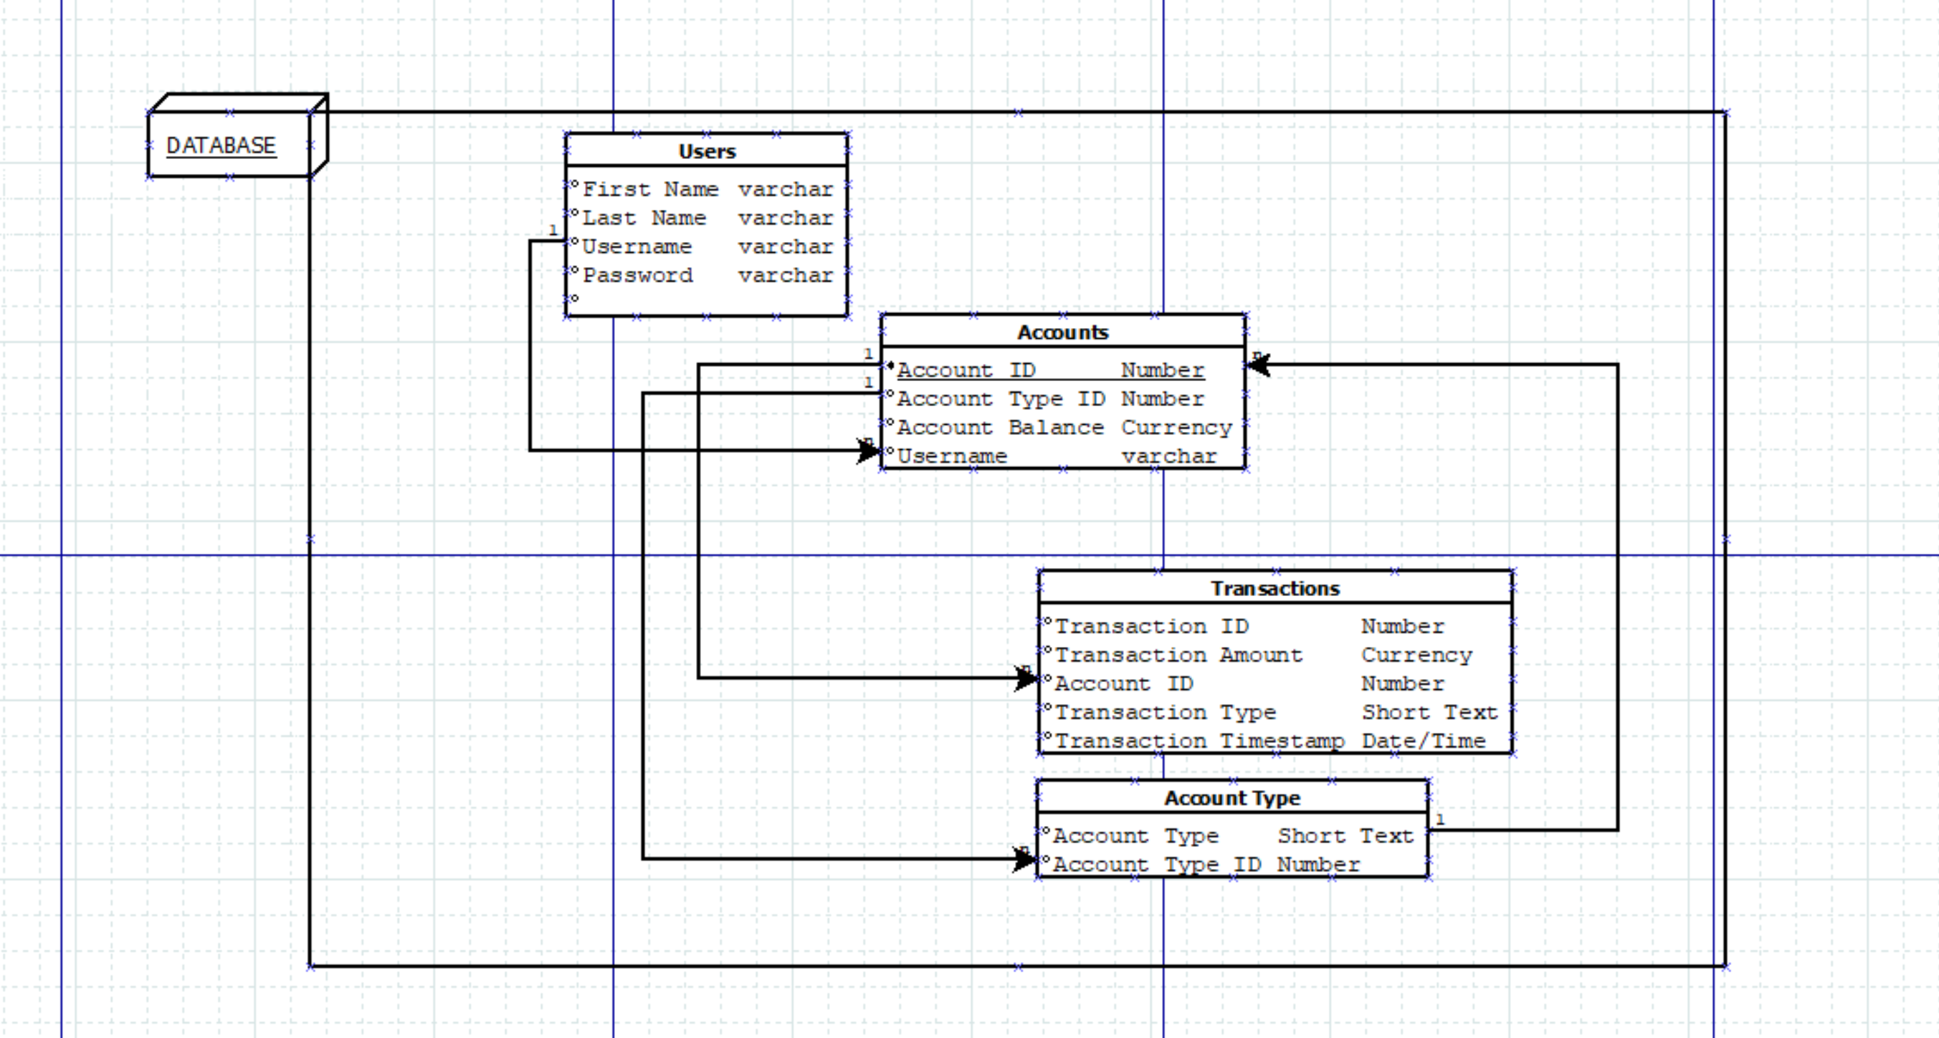

Slide 6
using system.info.demo static void main() { Demo projectDemo = new Demo(); projectDemo.make_good(); projectDemo.begin(); }

Slide 7
Future work
In the future we hope to expand on everything we have achieved already as well as implement real bank APIs and possible add a new investment section.

Slide 8
Questions
lucpfree@ut.utm.edu
bremwhit@ut.utm.edu
The Repo: https://github.com/lucianfreeze/CSCI352-Project-Freeze-Whitson

